Slide 1
Team REX
COSC 4P02

Slide 2
AGENDA
Introduction
Development Method
Sprint Overview
Tools
Challenges and Learnings
Future Development
Development Team
Application Demo
Q&A

Slide 3
Development Team
Name | Role | Brock ID
Parth Bhaveshbhai Patel | Product Owner/Developer | pp19oo
Akshar Patel | Product Owner/Developer | ap18zr
Naitik Hareshbhai Chovatiya | Scrum Master/Developer | nc18us
Aum Pandya | Developer | ap19xt
Anishka Shetty | Developer | as18cq
Darshakkumar Bambharoliya | Developer | db18hn
Sneh Patel | Developer | sp18oo

Slide 4

Introduction
Created an AR app with a goal of improving the experience of visiting museums
More enjoyable, more educational
Allows users to use their device to view more information about museum artifacts through pop-up cards along with interactive 3D visuals of artifacts and realistic scenes to enhance the museum experience
Incorporated an accessibility feature – Text-to-Speech, to allow users to listen to text on app
Target audience – all visitors
Easy to use
Provides artifact information directly on user's device

Slide 5
Development Method: Scrum
Used the Scrum methodology for our app
Agile incremental development process
An iterative approach
Flexible
Constant development, evaluation, and testing
Incremental delivery
Allowed us to receive feedback and make any needed corrections earlier on and throughout the process as we were able to see working versions of the app often
For a mid-sized AR project like ours, Agile was the best approach to increase transparency and accountability between team members and customers.
Scrum is easy to scale
Allows team to focus on tasks for each time period
Reach goals on a timely basis

Slide 6
Sprint Overview: 6 (2-week) Sprints
Sprint Planning
During plannings, the product owners and development team reviewed previous work and product backlog
The product owner created tasks for the next sprint and assigned them to the team
Daily Stand-Up
Daily 30-minute meeting to discuss progress and any blockers needing assistance

Slide 7
Sprint Overview: 6 (2-week) Sprints
Sprint Demo
After each sprint, we held a sprint demo meeting to showcase sprint work and receive feedback to improve
Attended by whole team
Regular sprint demos helped us achieve our goals and ensure stakeholder requirements were met
Sprint Retrospective
Held on last day of the sprint and attended by whole team
To bring up any issues and monitor the progress during ending sprint to make improvement for upcoming sprint

Slide 8




Tools for communication
Tools | Main purpose of the tool
Notion | To keep track of sprint planning and create the sprint/product backlog
Slack | For daily communication and progress updates
Google Meet | Used for daily scrum meetings
GitHub | Used for version control, collaboration, and continuous integration and deployment of the project

Slide 9
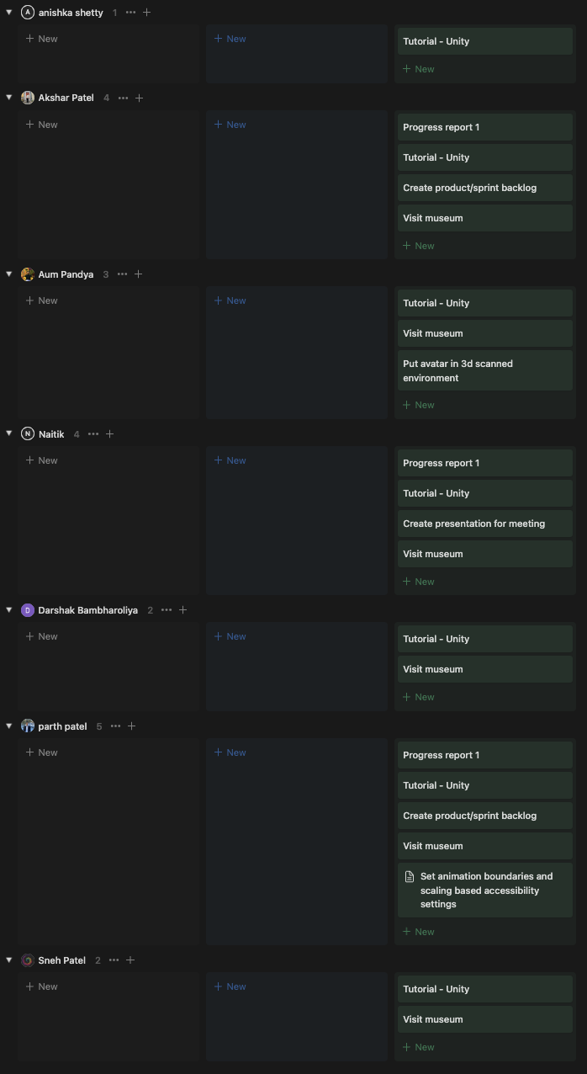
Notion
Sprint 1

Slide 10
Identifying our Blockers
High learning curve for SDKs
Started our project with React Native and Unity
Later, we realized that integration of Unity and React Native can be challenging and has a high learning curve
Had to change our development platform from React Native to Unity alone
Time management and availability
Team had different courses and work schedules which made it difficult to find times that worked for everyone
Sprint tasks were not always met on schedule sometimes, during midterm season for example.
Lead to things being pushed to next sprints – pile up of work at times

Slide 11
Identifying our Blockers
Delay due to unavailability of resource
Our AR project required to scan 3D artifacts of the museum
Needed to book an appointment with museum manager which was cancelled
Delayed our process for one week
Lack of stakeholder engagement and feedback
Difficult to know if the project was meeting requirements or expectations without feedback from stakeholders
May lead to delays in the project’s progress

Slide 12
Lessons Learned
It is important to have effective communication with all stakeholders prior to the starting the project
Avoid delays in completion of required tasks
Manage time effectively
Review project plan often and adjust it accordingly
To avoid any potential blockers in the development process
To guarantee a quick learning curve for the team, adequate training and support should be offered for any new tools or technologies used in the project

Slide 13

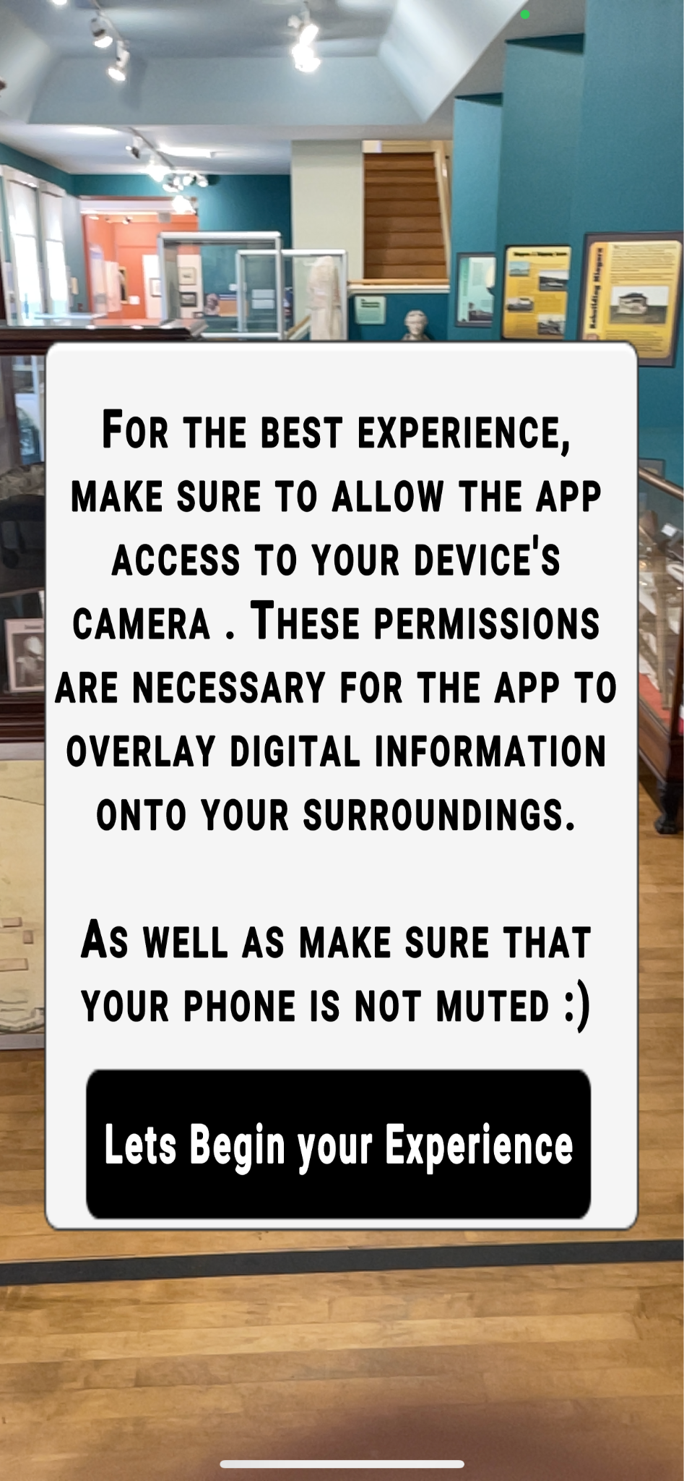
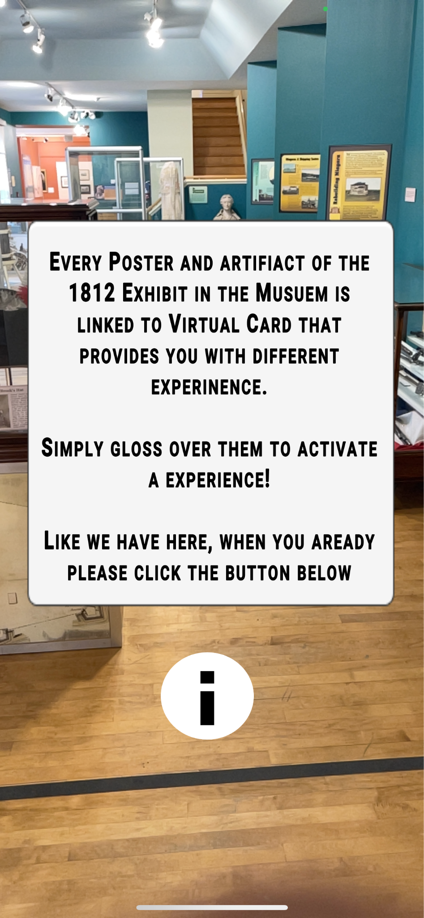
}

Slide 14
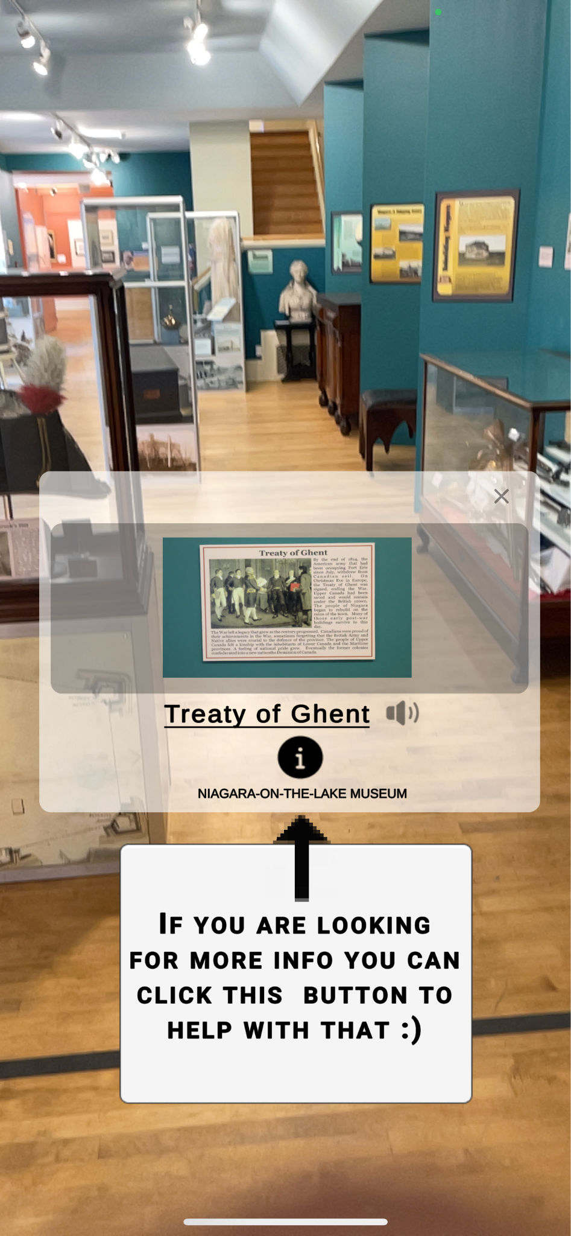
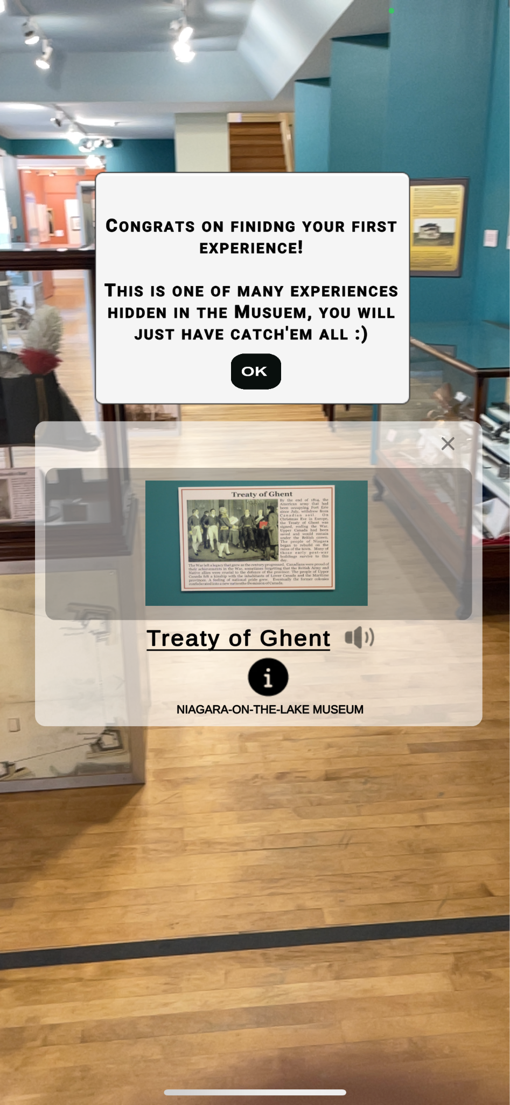

}

Slide 15
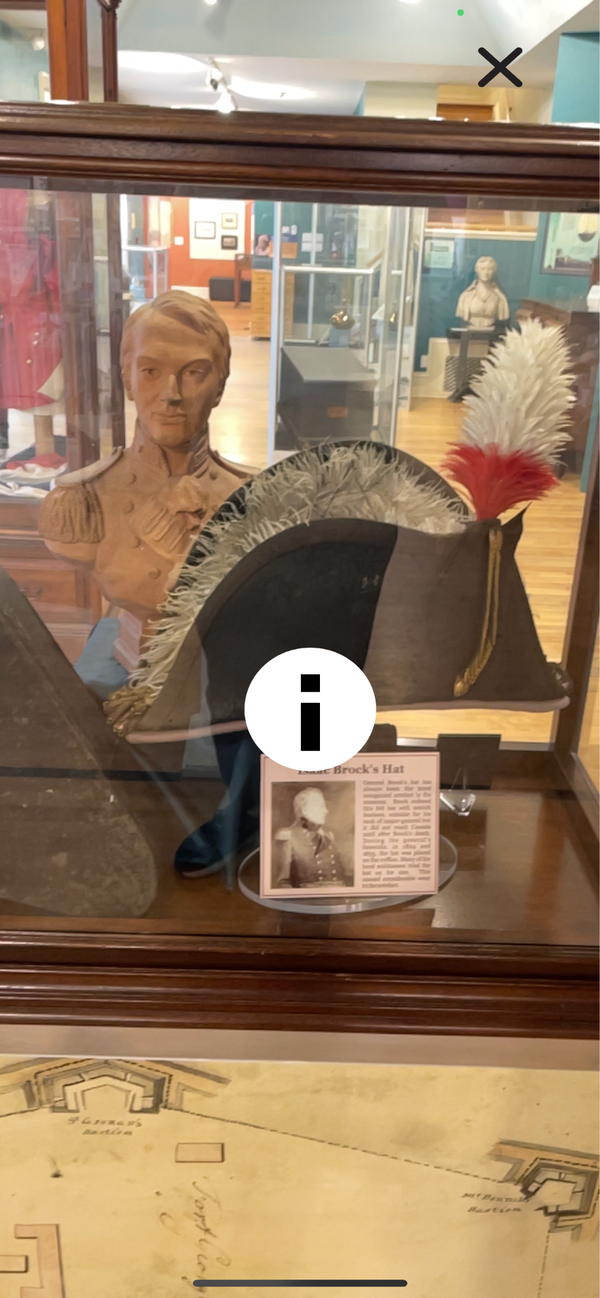
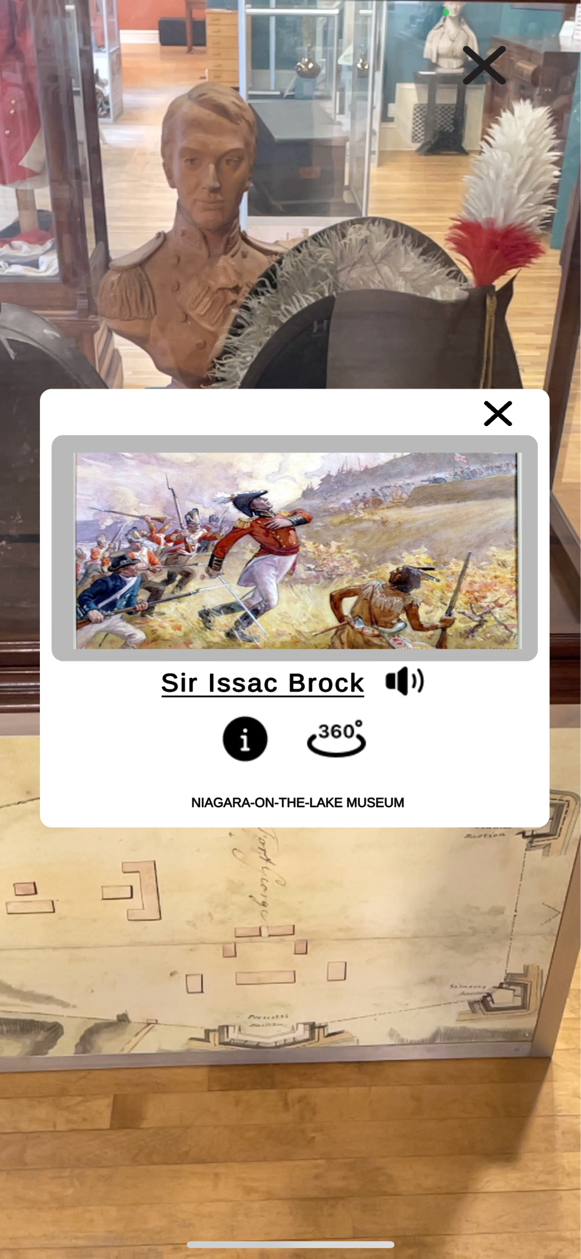
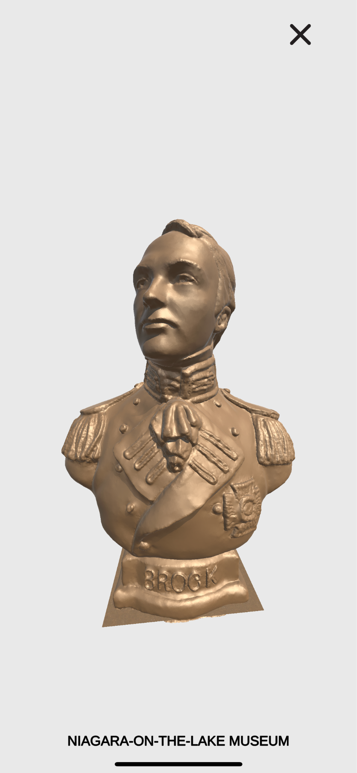
}

Slide 16
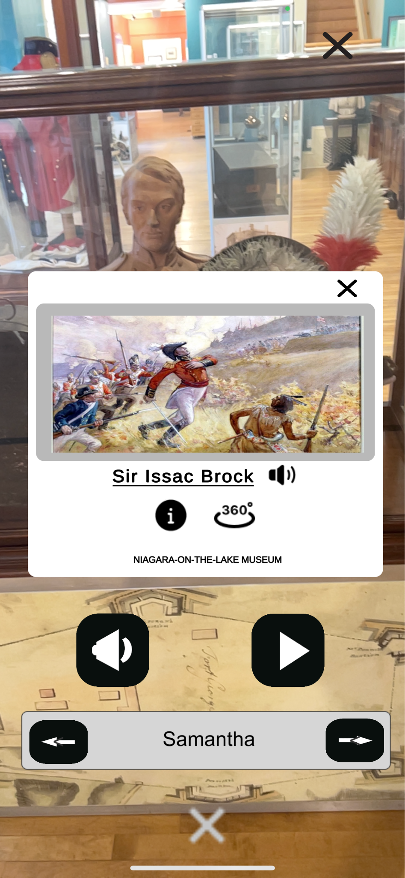
}

Slide 17
Application Demo

Slide 18

Q&A

